Slide 1
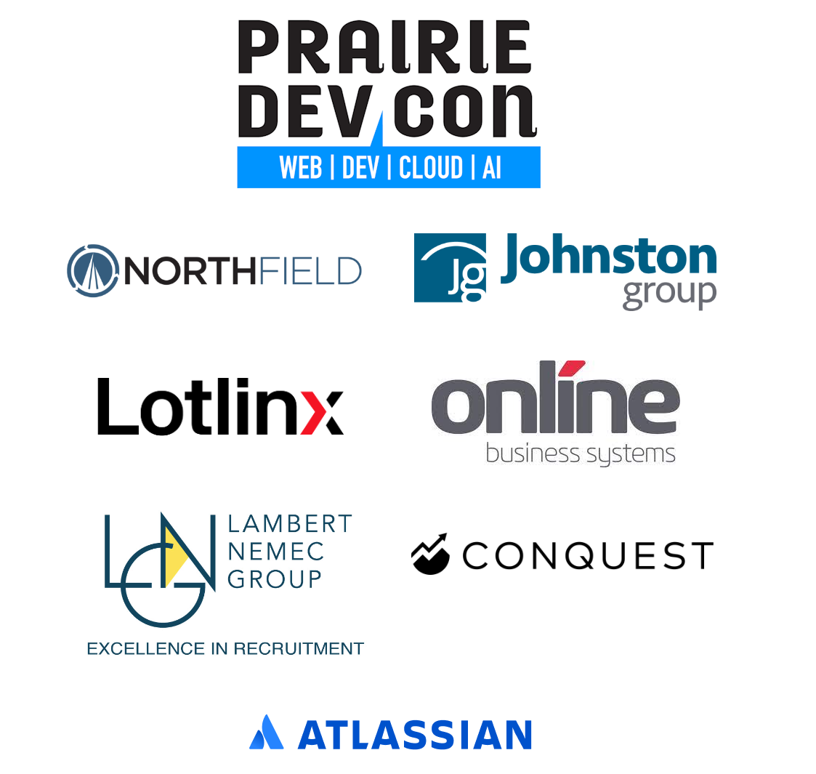
Introduction to .NET Aspire

Slide 2
Introduction to .NET Aspire
Peter Ritchie
Prairie DevCon (PrDC) Winnipeg 2024

Slide 3
Peter Ritchie
From National Capital Region
3 decades of delivering software
Thirteen-time Microsoft MVP, developer technologies
Independent Consultant
Speaker, Blogger, Author, Open-Source Contributor

Slide 4

Notes:
The Ottawa airport has a lounge named Aspire Lounge. I thought that was interesting, this session is not about that lounge

Slide 5
Motivation of .NET Aspire
Developer inner loop
Configure, execute, orchestrate, and debug distributed systems locally
One-click start
Local orchestration
Service discovery
Cloud-Native:
Observability, Resiliency, Scalability, Manageability
Notes:
How many people here have tried to debug a distributed application?
Local configuration without affecting other environments or leaking secrets
Connection strings, hostnames+ports, etc.
Execution of all the projects and debugging?
It squarely addresses the ability of developers to quickly and reliably local orchestrate a distributed system with minimal fuss.
Observability: open telemetry
Resiliency: Polly, etc.
Scalability: supporting cloud
Manageability: Manage resources: containers, executables, cloud resources

Slide 6
Requirements
.NET 8+
Docker Desktop or Podman

Slide 7
“.NET Aspire is to docker-compose as TypeScript is to JavaScript”

Slide 8
Demo
Notes:
Create Aspire Starter App
AppHost.Program
DistributedApplication.CreateBuilder
AddRedis (cache)
AddProject (api)
AddProject (frontend)
Web.Program
builder.AddServiceDefaults()
Builder.AddRedisOutputCache (adds Redis.IConnectionMultiplexer
AddHttpClient, using name used in AppHost.Program
app.MapDefaultEndpoints
ApiService.Program
builder.AddServiceDefaults()
app.MapDefaultEndpoints()
F5
- Goto web page, show trace
- Go to health endpoing for web and api
Deploy via cli
azd init
azd auth login
azd up
Go to portal.azure.com
Go to resource group
Go to webfrontend resource
Click application url
Click .NET Aspire Dashboard (Open Dashboard)
az group delete --name rg-rg-TempAspire
Open new other solution with postgresql and show integrations (posgresql, etc.).
Integrations: cache, API, frontend
Integrations

Slide 9
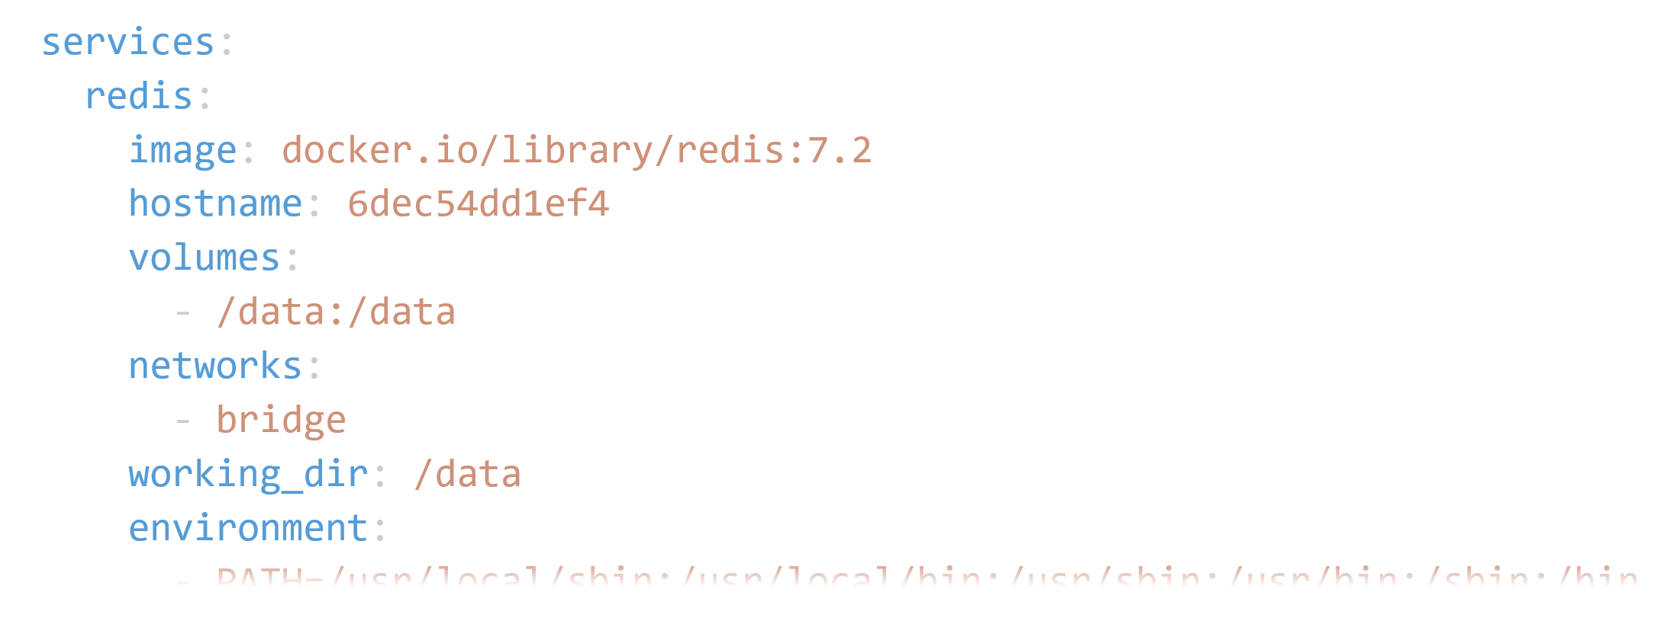
Docker Compose?
docker run -d docker.io/library/redis:7.2 `
--workdir=/data --volume=/data `
--restart=no -p 127.0.0.1:6379 `

Slide 10
Principles
Make the implicit explicit

Slide 11
Criticisms/Caveats
.NET only?
Visual Studio Only?
Azure only?
Single Visual Studio solution
azd up, single bicep file (not a DevOps pipeline, stage, etc.
Dashboard storage is in-memory only

Slide 12
Why I think Aspire matters

Slide 13
Summary
Production Ready?
Distributed Monolith?
Notes:
Probably not production ready. I have yet to work in an environment where a distributed application is deployed all at once and based entirely on a single solution.

Slide 14




Peter Ritchie
@peteraritchie
/in/peteraritchie
peteraritchie
peter@peterritchie.com
Resources:
theurlist.com/prdc-ywg-aspire
aspireify.net

